Slide 1
Student: Nikolas Daniel Vincenti Matriculation: 9211929
Course: DLBCSPJWD01 - Project Java and Web Development - 19/06/2025 GitHub Repository: https://github.com/NikVince/ai-chat-interface Live: https://ai-chat-interface-nine.vercel.app/
AI Chat Interface

Slide 2
Project purpose
Target Users: Developers, students, and professionals
Core Value Proposition: Privacy-first AI chat interface where users provide their own OpenAI API keys
Key Benefits:
Complete data privacy (no third-party storage)
Cost transparency and control
Direct API usage without intermediaries
Model selection (GPT-3.5-turbo vs GPT-4)
Problem Solved: Secure AI assistance without compromising privacy or losing control over API costs

Slide 3
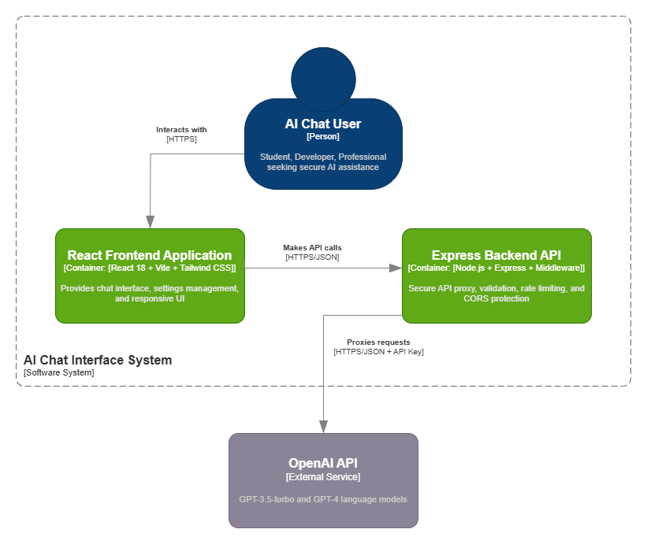
ArchitectureDiagram

Slide 4
Tech Stack
Frontend Technologies:
React 18 (modern functional components with hooks)
Vite (fast development server, replaces deprecated CRA)
Tailwind CSS (utility-first responsive design)
Backend Technologies:
Node.js + Express.js (API server)
OpenAI SDK (official integration)
Middleware: CORS, rate limiting, input validation
Integration: RESTful API communication, secure proxy pattern

Slide 5
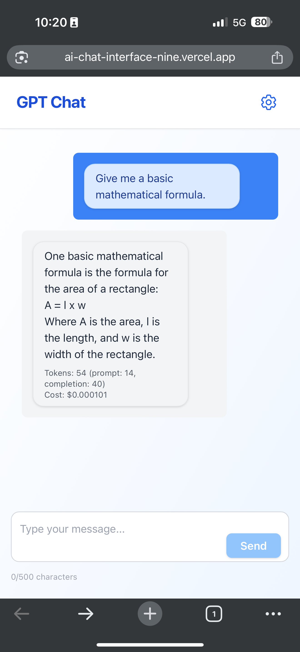
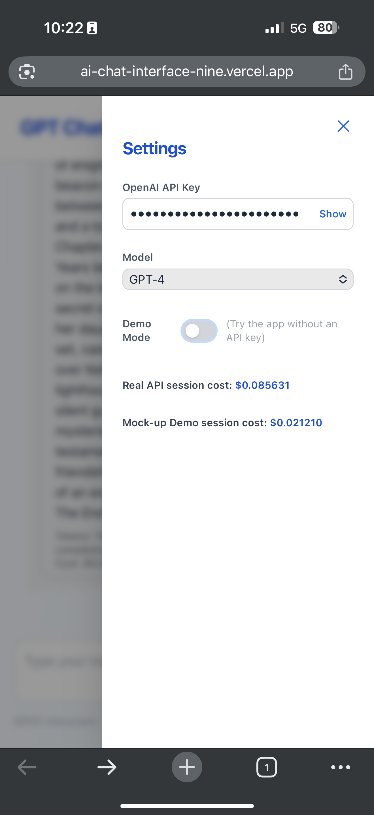
Mobile first approach
Chat Interface: Real-time messaging, markdown support with fast response.
Settings Panel: API key input, model selection, demo toggle.
Mobile View: Stacked layout, touch-friendly controls.
Demo Mode: Simulated chat for evaluation.
Cost Tracker: For real API cost.

Slide 6
Development journey
Feature/Decision | Phase 1 Proposal | Phase 2 Implementation | Reason
API Key Handling | Secure proxy pattern - backend-only, never stored permanently | Session-based, backend proxy; API key validated per request, never stored | Improved security, assignment requirement
Demo Mode | Demo mode toggle (Settings Management dynamic aspect) | Fully implemented: toggleable, simple responses to test chat, no API key required | Helpful for evaluating chat functionality
UI Framework | React 18 + Vite + Tailwind CSS | Tailwind CSS only mobile-first, responsive, React functional comps | Assignment requirement, mobile-first focus
Error Handling | Input validation, rate limiting, HTTPS encryption | Comprehensive: input validation, rate limiting, global error middleware, user-friendly frontend errors | Assignment requirement, robust UX
Deployment | Not initially taken into consideration | Vercel deployment, HTTPS-ready, environment config, documented in /docs/vercel_deployment_guide.md | Production-readiness and simplicity during evaluation
NOTE: A more in depth documentation about changes between development phases is available at: /docs/design_choices_and_changes.md inside the repository.

Slide 7
Dynamic Aspects
Real-Time Chat:
The chat interface enables users to exchange messages instantly with the AI. Features include live message updates, automatic scrolling to the latest message, and visual loading indicators while awaiting responses. This creates a seamless, interactive chat experience.
Chat Export:
Users can instantly export their entire chat history as a downloadable file, enabling easy sharing or record-keeping with a single click.

Slide 8
Security & Best Practices
API keys never stored in frontend: Entered by user, sent securely to backend per request, never persisted or exposed to third parties.
Input validation: All user input is checked and sanitized on the backend.
Rate limiting & CORS: Prevents abuse and restricts API access to trusted origins.
No sensitive errors: Error messages never reveal private details.
HTTPS-ready: Configured for secure deployment out of the box.

Slide 9
Installation & Usage
Live app at: https://ai-chat-interface-nine.vercel.app/
Or Run Locally:
git clone https://github.com/NikVince/ai-chat-interface.git
Install dependencies:
cd backend && npm install
cd ../frontend && npm install
Run backend:
npm start
Run frontend:
npm run dev
Open in browser: http://localhost:5173

Slide 10
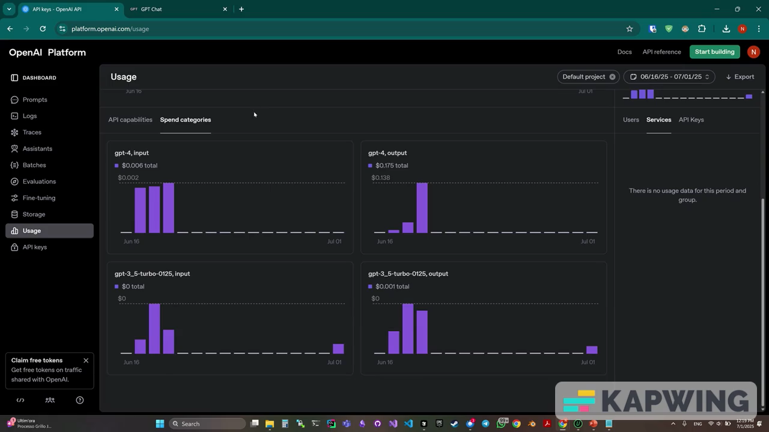

Slide 11
Thank you
Nikolas Daniel Vincenti
nikolas.vincenti@iu-study.org
nik.vincenti.dev@gmail.com
https://github.com/NikVince
CLOSING NOTE:
If the demo mode does not fully meet your evaluation needs, I can provide a temporary OpenAI API key upon request. Please feel free to contact me via one of the emails listed above.

